Slide 1

Data Analytics Master Program
1.Comprehensive Industry-Oriented Curriculum
2.Learn Excel, SQL, Power BI, Tableau & Python
3.Real-World Projects & Case Studies
4.Placement Assistance & Interview Preparation
5.Industry Recognized Certification
Duration
6 Months | 100+ Hours Training | Live Projects

Slide 2

Why Learn Data Analytics?
High Industry Demand
Organizations rely on data-driven decisions to improve performance and profitability.
Attractive Salary Packages
Data Analytics professionals earn competitive salaries across industries.
Career Growth
Rapid career progression with opportunities in analytics, BI, and management.
Future-Proof Skill
One of the most in-demand skills in the digital economy.

Slide 3

Career Opportunities
Job Roles
Data Analyst
Business Analyst
Power BI Developer
Tableau Developer
BI Analyst
Reporting Analyst
Data Visualization Specialist
Analytics Consultant

Slide 4
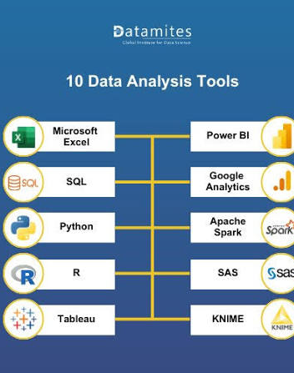
Tools Used in Industry
Microsoft Excel
Advanced Data Analysis & Reporting
SQL
Database Querying & Data Extraction
Power BI
Business Intelligence Dashboards
Tableau
Interactive Data Visualization
Google Analytics
Website & Marketing Analytics

Slide 5
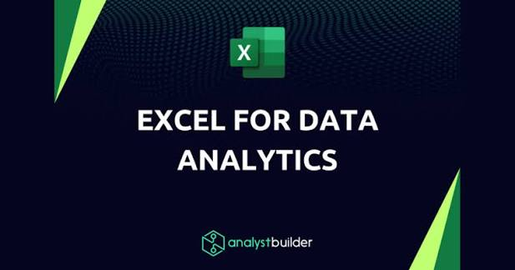
Excel Analytics
Topics Covered
Data Cleaning
Conditional Formatting
Pivot Tables
Pivot Charts
Advanced Formulas
XLOOKUP
INDEX & MATCH
Dashboard Creation
Business Use Cases
Sales Reports
Inventory Tracking
KPI Dashboards

Slide 6

SQL Analytics
SQL Concepts
SELECT Statements
WHERE Clause
ORDER BY
GROUP BY
HAVING
INNER JOIN
LEFT JOIN
RIGHT JOIN
Subqueries
Real-World Usage
Customer Analysis
Sales Reporting
Data Extraction

Slide 7
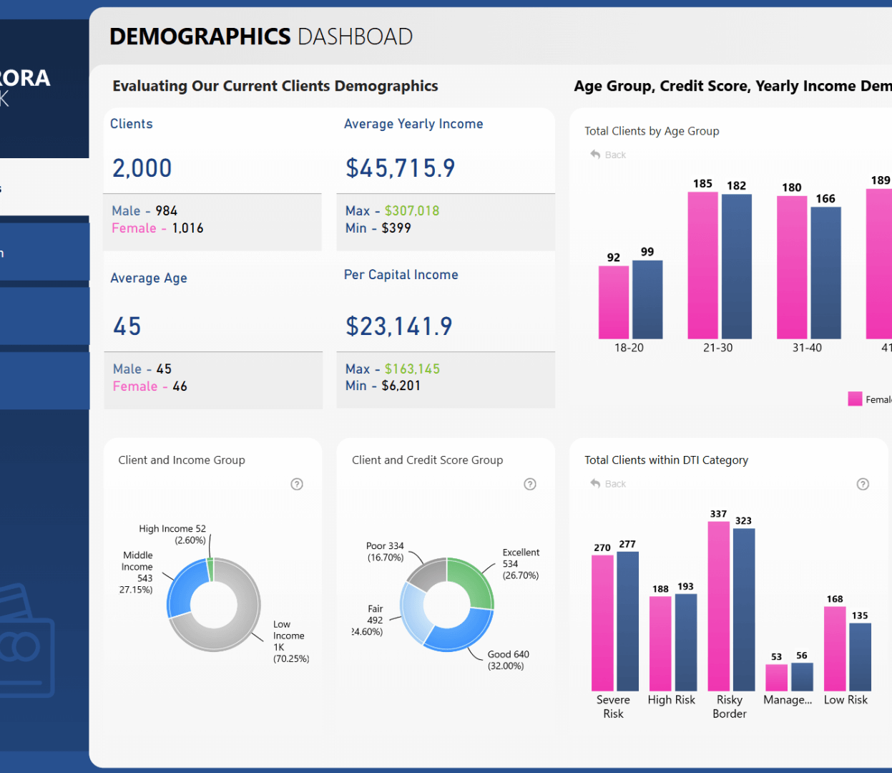
Power BI
Key Modules
Data Import
Data Transformation
Power Query
Data Modeling
DAX Functions
Dashboard Development
Report Publishing
Benefits
Interactive Dashboards
Real-Time Reporting
Business Insights

Slide 8

Python for Analytics
Python
Core python
Pandas
NumPy
Matplotlib
Seaborn
Django FRamework
Skills Learned
Data Cleaning
Data Analysis
Data Visualization
Business Reporting

Slide 9

Business Analytics
KPI Analysis
Track key performance indicators for business success.
Sales Analytics
Identify sales trends and growth opportunities.
Marketing Analytics
Measure campaign performance and ROI.
Financial Analytics
Monitor profitability and business performance.

Slide 10

Certifications
Course Completion Certificate
Industry-Oriented Training Certificate
Project Completion Certificate
Benefits
Strengthens Resume
Enhances Job Opportunities
Demonstrates Practical Skills
Industry Recognition

Slide 11

Placement & Interview Preparation
Placement Assistance
Resume Building
Portfolio Development
LinkedIn Optimization
Job Application Support
Interview Preparation
Mock Interviews
Technical Interview Questions
HR Interview Guidance
Case Study Discussions

Slide 12

Start Your Data Analytics Journey Today!
Contact Us
Tech Kraftiers Digital
F-19-A, Haware’s Centurion Mall,Sector 19A, Nerul East, Navi Mumbai – 400706
📞 Phone Number +91 7738415492
📧 Email Address info@techkraftiersdigital.in
🌐 Website www.techkraftiersdigital.in

